Slide 1

Capstone project-
The battle of neighbour-hoods
Selecting the best location to open sushi restaurant in downtown Toronto

Slide 2
INTRODUCTION
Toronto is Canada’s largest city. Its large population of immigrants from all over the globe has also made Toronto one of the most multicultural cities in the world. Its large population of immigrants from all over the globe has also made Toronto one of the most multicultural cities in the world.
This means that the market is highly competitive. As it is highly developed city so cost of doing business is also one of the highest. Thus, any new business venture or expansion needs to be analyzed carefully.
Sushi restaurants have become very popular and thriving in Canada, now it seems that there is one on every corner, not only in major cities but also in smaller cities. Starting a sushi restaurant can be a great business opportunity, but one needs to distinguish themselves from others to enjoy long-term success in the market.

Slide 3
BUSINESS PROBLEM
My Client has preferred to open his business in Downtown, Toronto area, so I will only be focusing on that borough during my analysis. The objective is to locate and recommend to the management which location in Downtown area will be the best choice to start a restaurant. The Management also expects to understand the rationale of the recommendations made.
We define potential neighborhood based on the number of sushi restaurants which are operating right in each neighborhood. Downtown, Toronto has full potential but also is a very challenging district to open a business because of high competition.
Therefore, this analysis necessary to ensure that we have enough customers and that we are not so close to other sushi places.

Slide 4

DATA SELECTION
To identify the characteristics of our competitors' venues In Downtown, Toronto, we would first need to find out the number of sushi bars in Downtown currently and their location.
We then used Google Map API to find their geographic coordinates based on their postal code addresses.
In Downtown, Toronto, 781 sushi restaurants are currently operating.

Slide 5
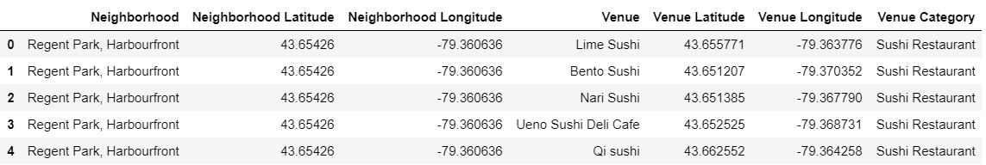
DATA SELECTION(cont.)
Next, we also used Google Map API to find their geographic coordinates of the 5 locations shortlisted for our sushi restaurant:

Slide 6
METHODOLOGY
Addresses have been converted into their equivalent latitude and longitude values.
Foursquare API is used to explore neighborhoods in Downtown, Toronto.
After that, explore function is used to get sushi restaurant categories in each neighborhood.

Slide 7
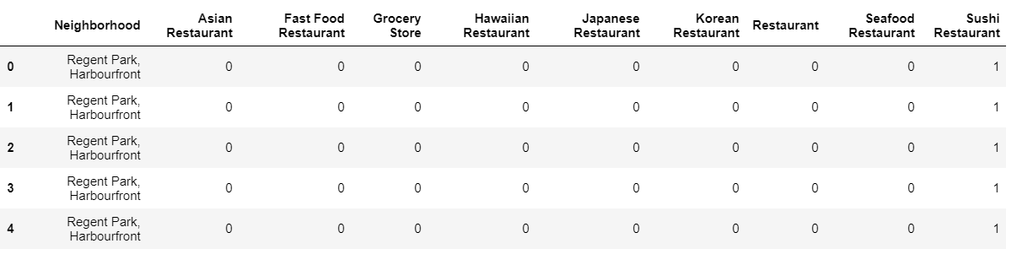
METHODOLOGY(cont.)

Slide 8
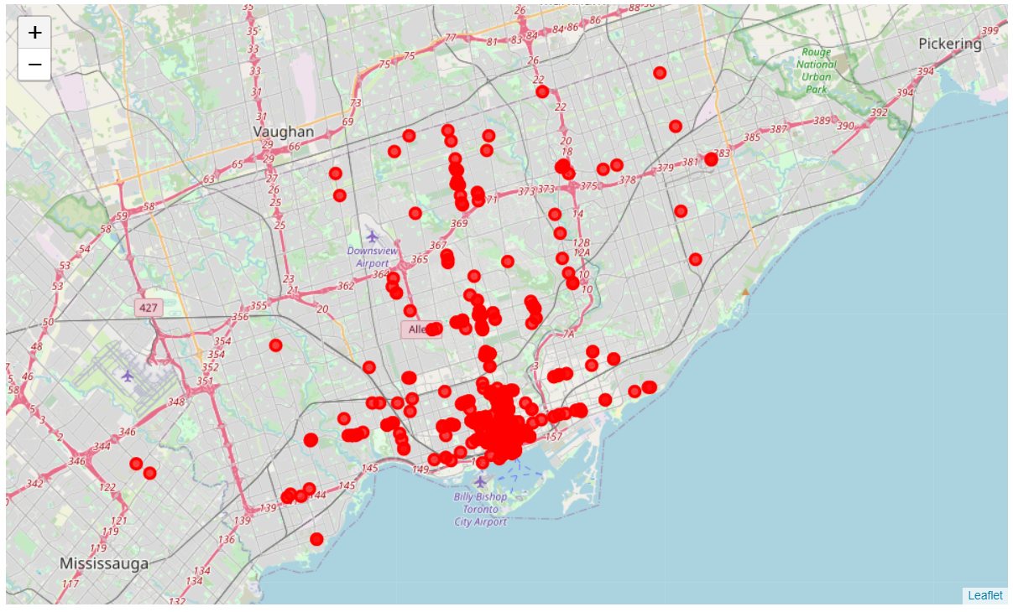
Methodology(cont.)
Sushi Restaurants in Downtown, Toronto

Slide 9
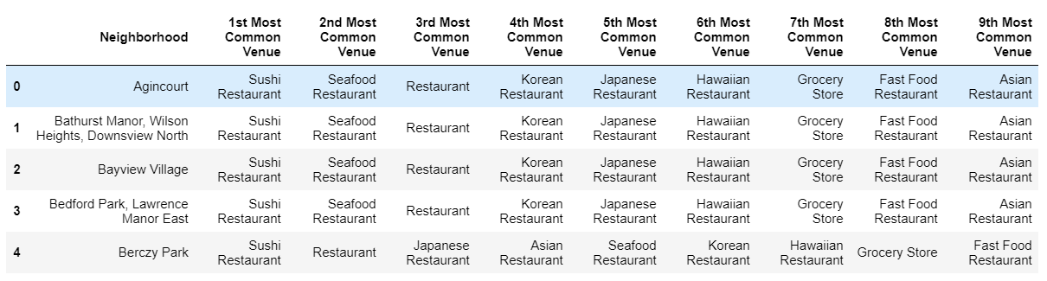
Methodology(cont.)
Then using K-means clustering algorithm to group the neighborhoods into clusters to complete this task. And also, the Folium library to visualize the neighborhoods in Downtown, Toronto and its emerging clusters.

Slide 10
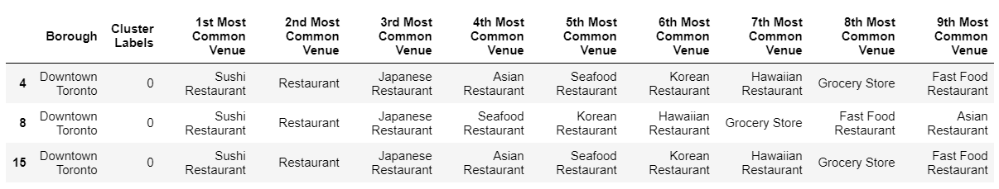
results
Cluster 0:

Slide 11
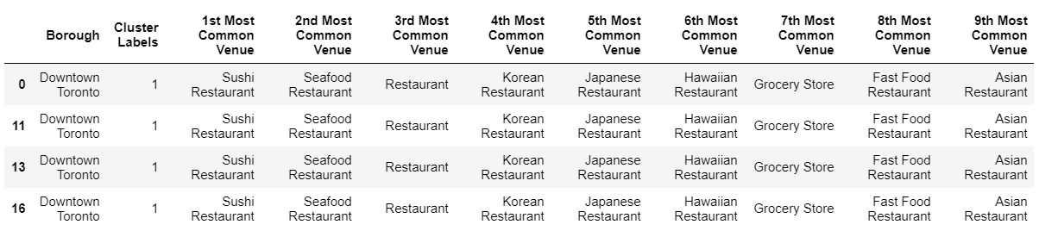
Results (cont.)
Cluster 1:

Slide 12
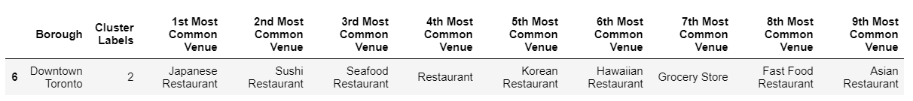
Results (cont.)
Cluster 2

Slide 13
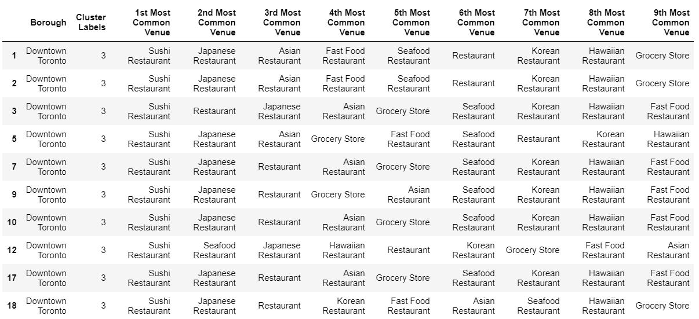
Results (cont.)
Cluster 3:

Slide 14
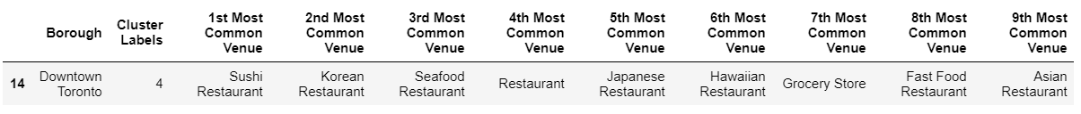
Results (cont.)
Cluster 4:

Slide 15
discussion
This analysis is performed on limited data. This may be right or may be wrong. But if good amount of data is available there is scope to come up with better results.
There is high competition in cluster 1 and cluster 3 areas so it is very risky to open business in these areas.
Cluster 0 also has potential.
It can be done with more detailed analysis by adding other factors such as transportation and demographics of inhabitants.

Slide 16
Conclusion
Based on data frame analysis Cluster 2 and Cluster 4 areas are the best places to open a new sushi bar business.
Although all of the goals of this project were met there is definitely room for further improvement and development as noted below. However, the goals of the project were met and, with some more work, could easily be developed into a fully pledged application that could support the opening a business idea in an unknown location.
As per the neighborhood or restaurant type mentioned like Sushi restaurants analysis can be checked. A venue with lowest risk and competition can be identified.

